Slide 1
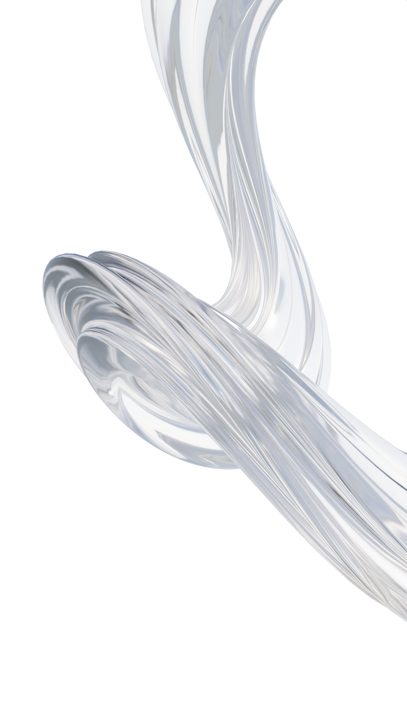


BUSINESS PROPOSAL
PRESENTATION (27 March 2025)

Slide 2
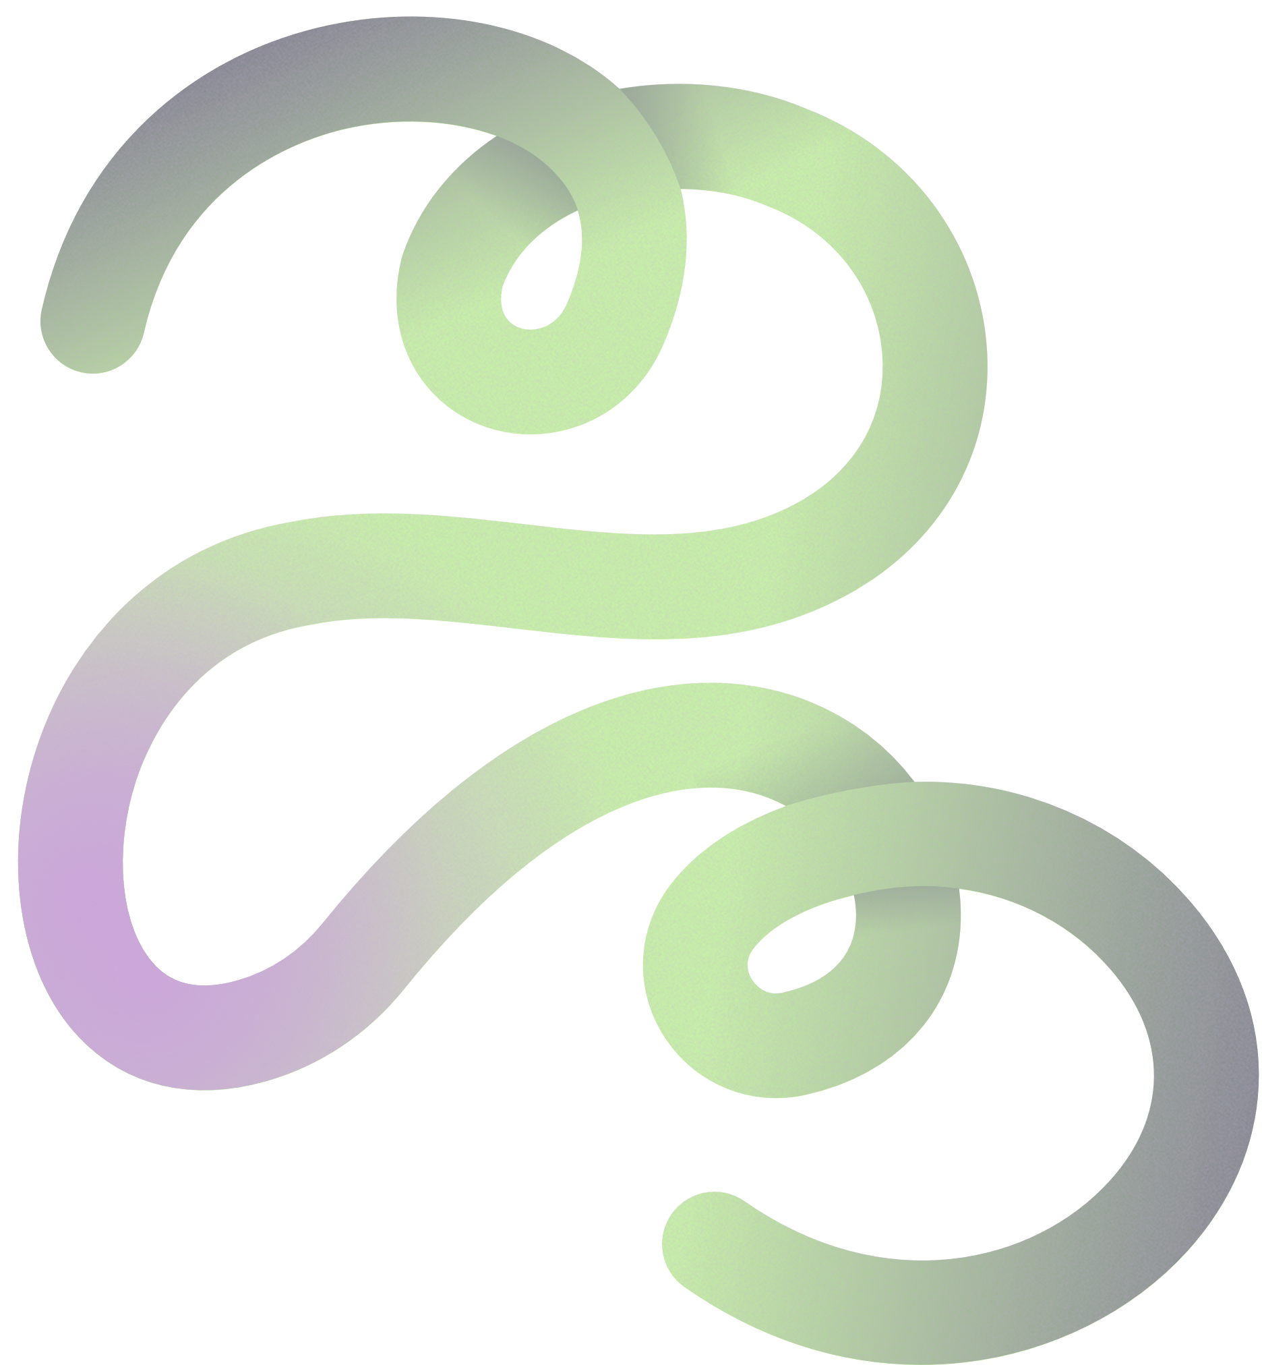


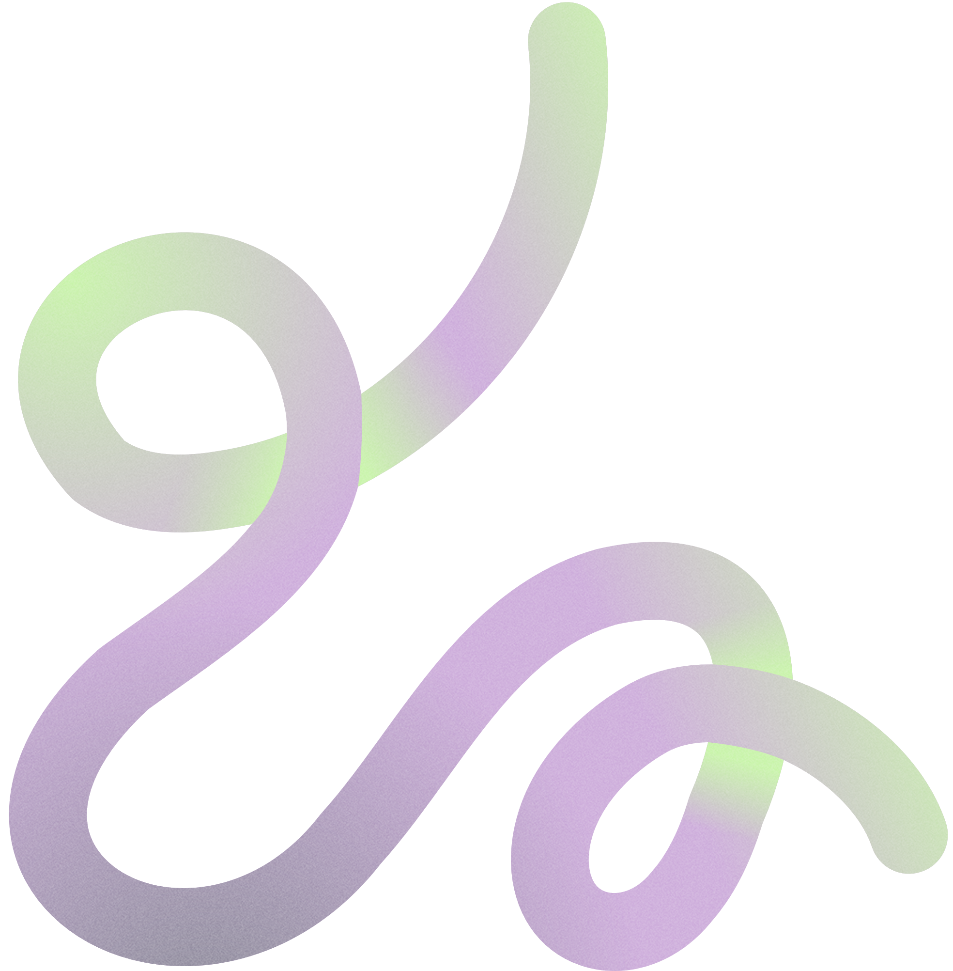
Meet Our
TEAM
"The Minds Behind the Storm"
⚡🔥

Slide 3




TEAM VAJRA STORM
Disrupt like Thunder, Build like Vajra!
INNOVARE TECHNICAL CLUB

Slide 4
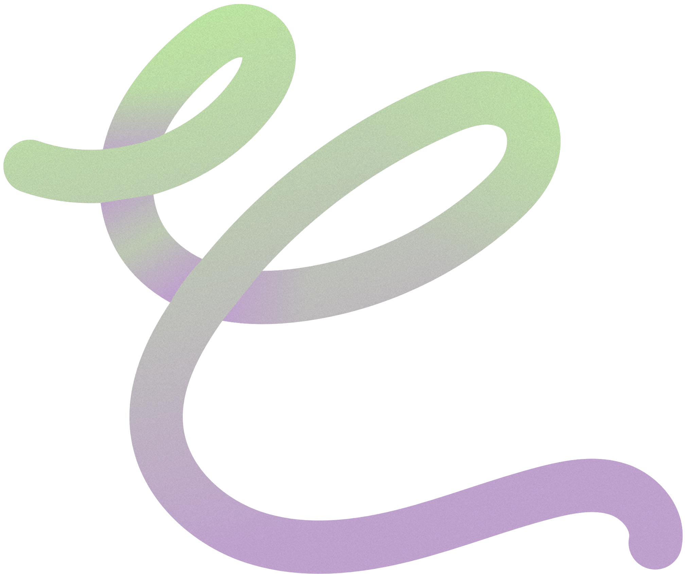
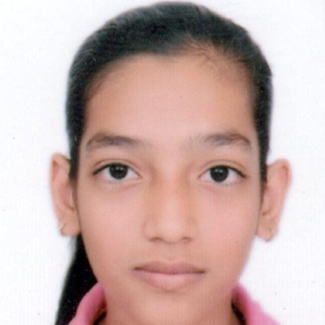
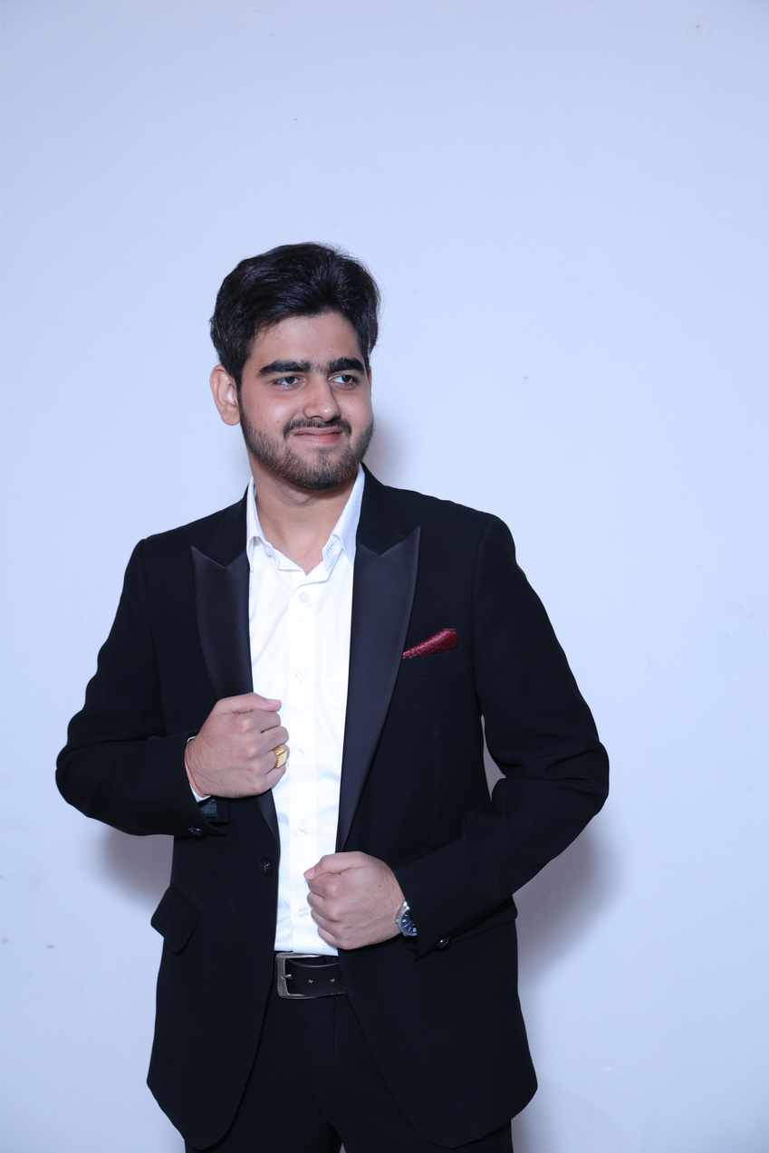
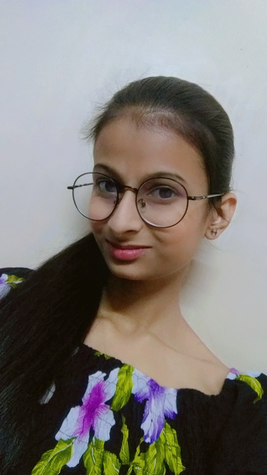
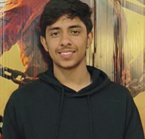
TEAM MEMBER HIGHLIGHTS
Get to know some of our team members
RIYA GUPTA
ATUL VERMA
TANISHA JAIN
SAKSHAM JUNEJA
Team Leader , Core Idea Creator & Pitch Strategist
Visit my socials:
guptariya1092@gmail.com
Business Development & Market Analyst
Visit my socials: atulverma9728@gmail.com
Innovation & Research Lead
Visit my socials: tanishajain274@gmail.com
Support & Review Analyst
Visit my socials: @saksham.juneja007@gmail.com

Slide 5
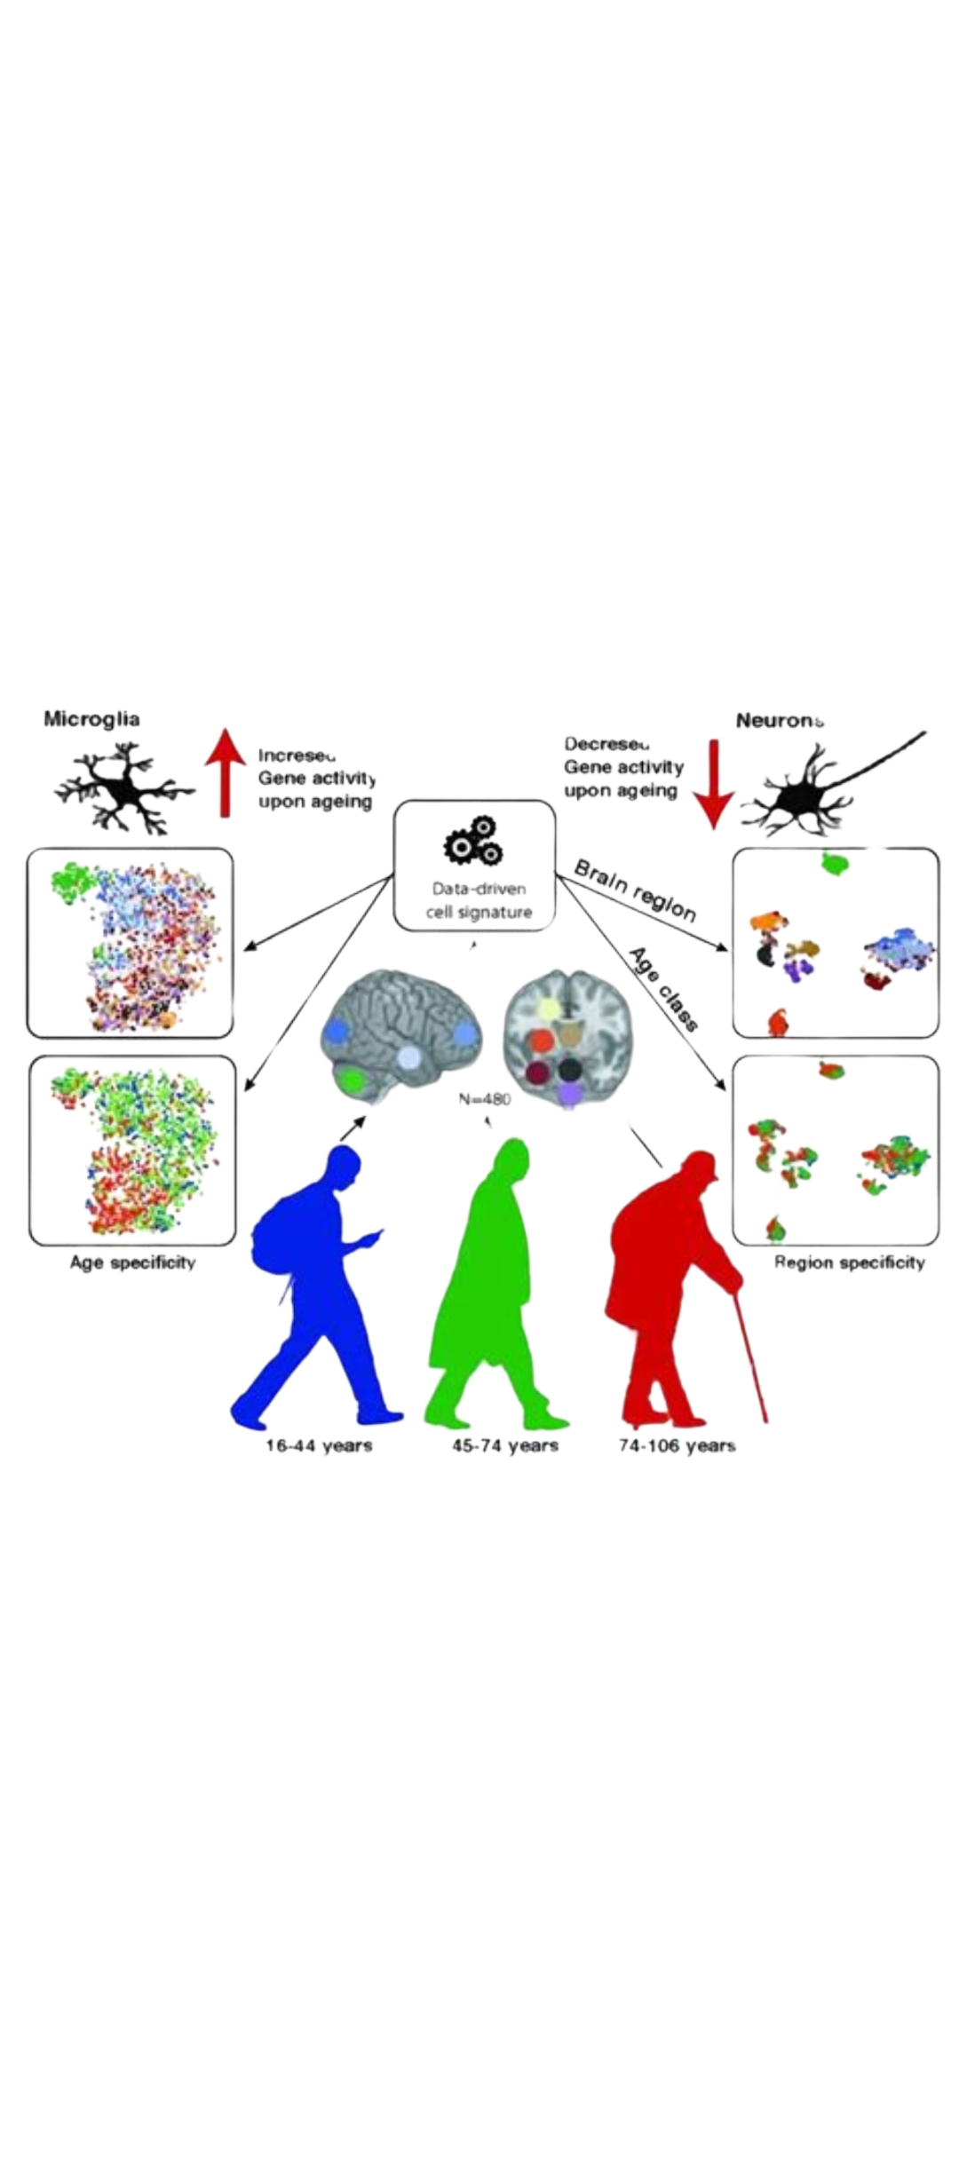

Slide 6
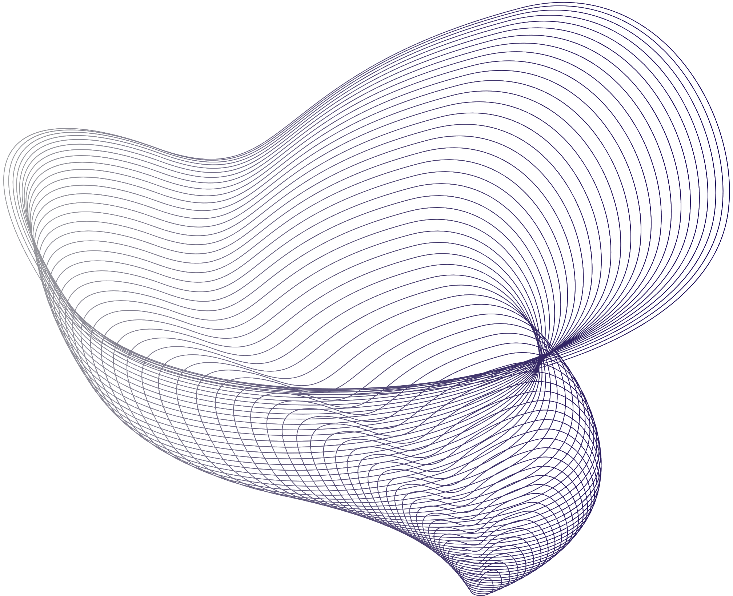
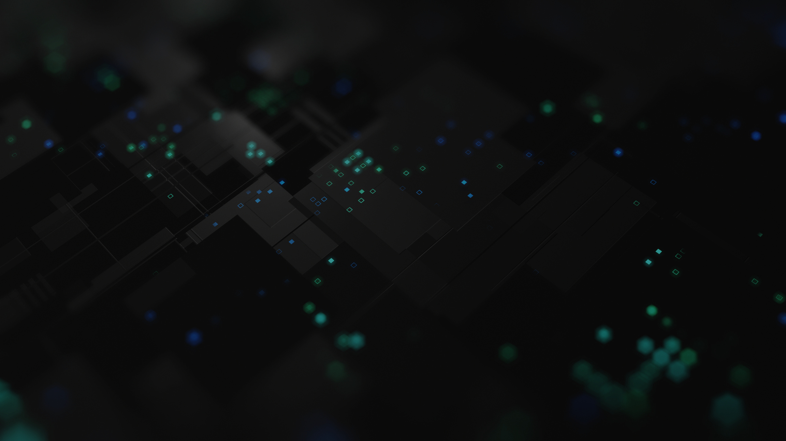
PROBLEM STATEMENT
(The Ultimate Human Limitation) 🧠
"
2
1
Further Problem
Human Brain
The Human Brain is a biological system that is affected by ageing , diseases and memory loss.
After death , knowledge , experiences and intelligence are wasted.
There is no realistic mass-adoptable solution for AI and consciousness integration yet.

Slide 7
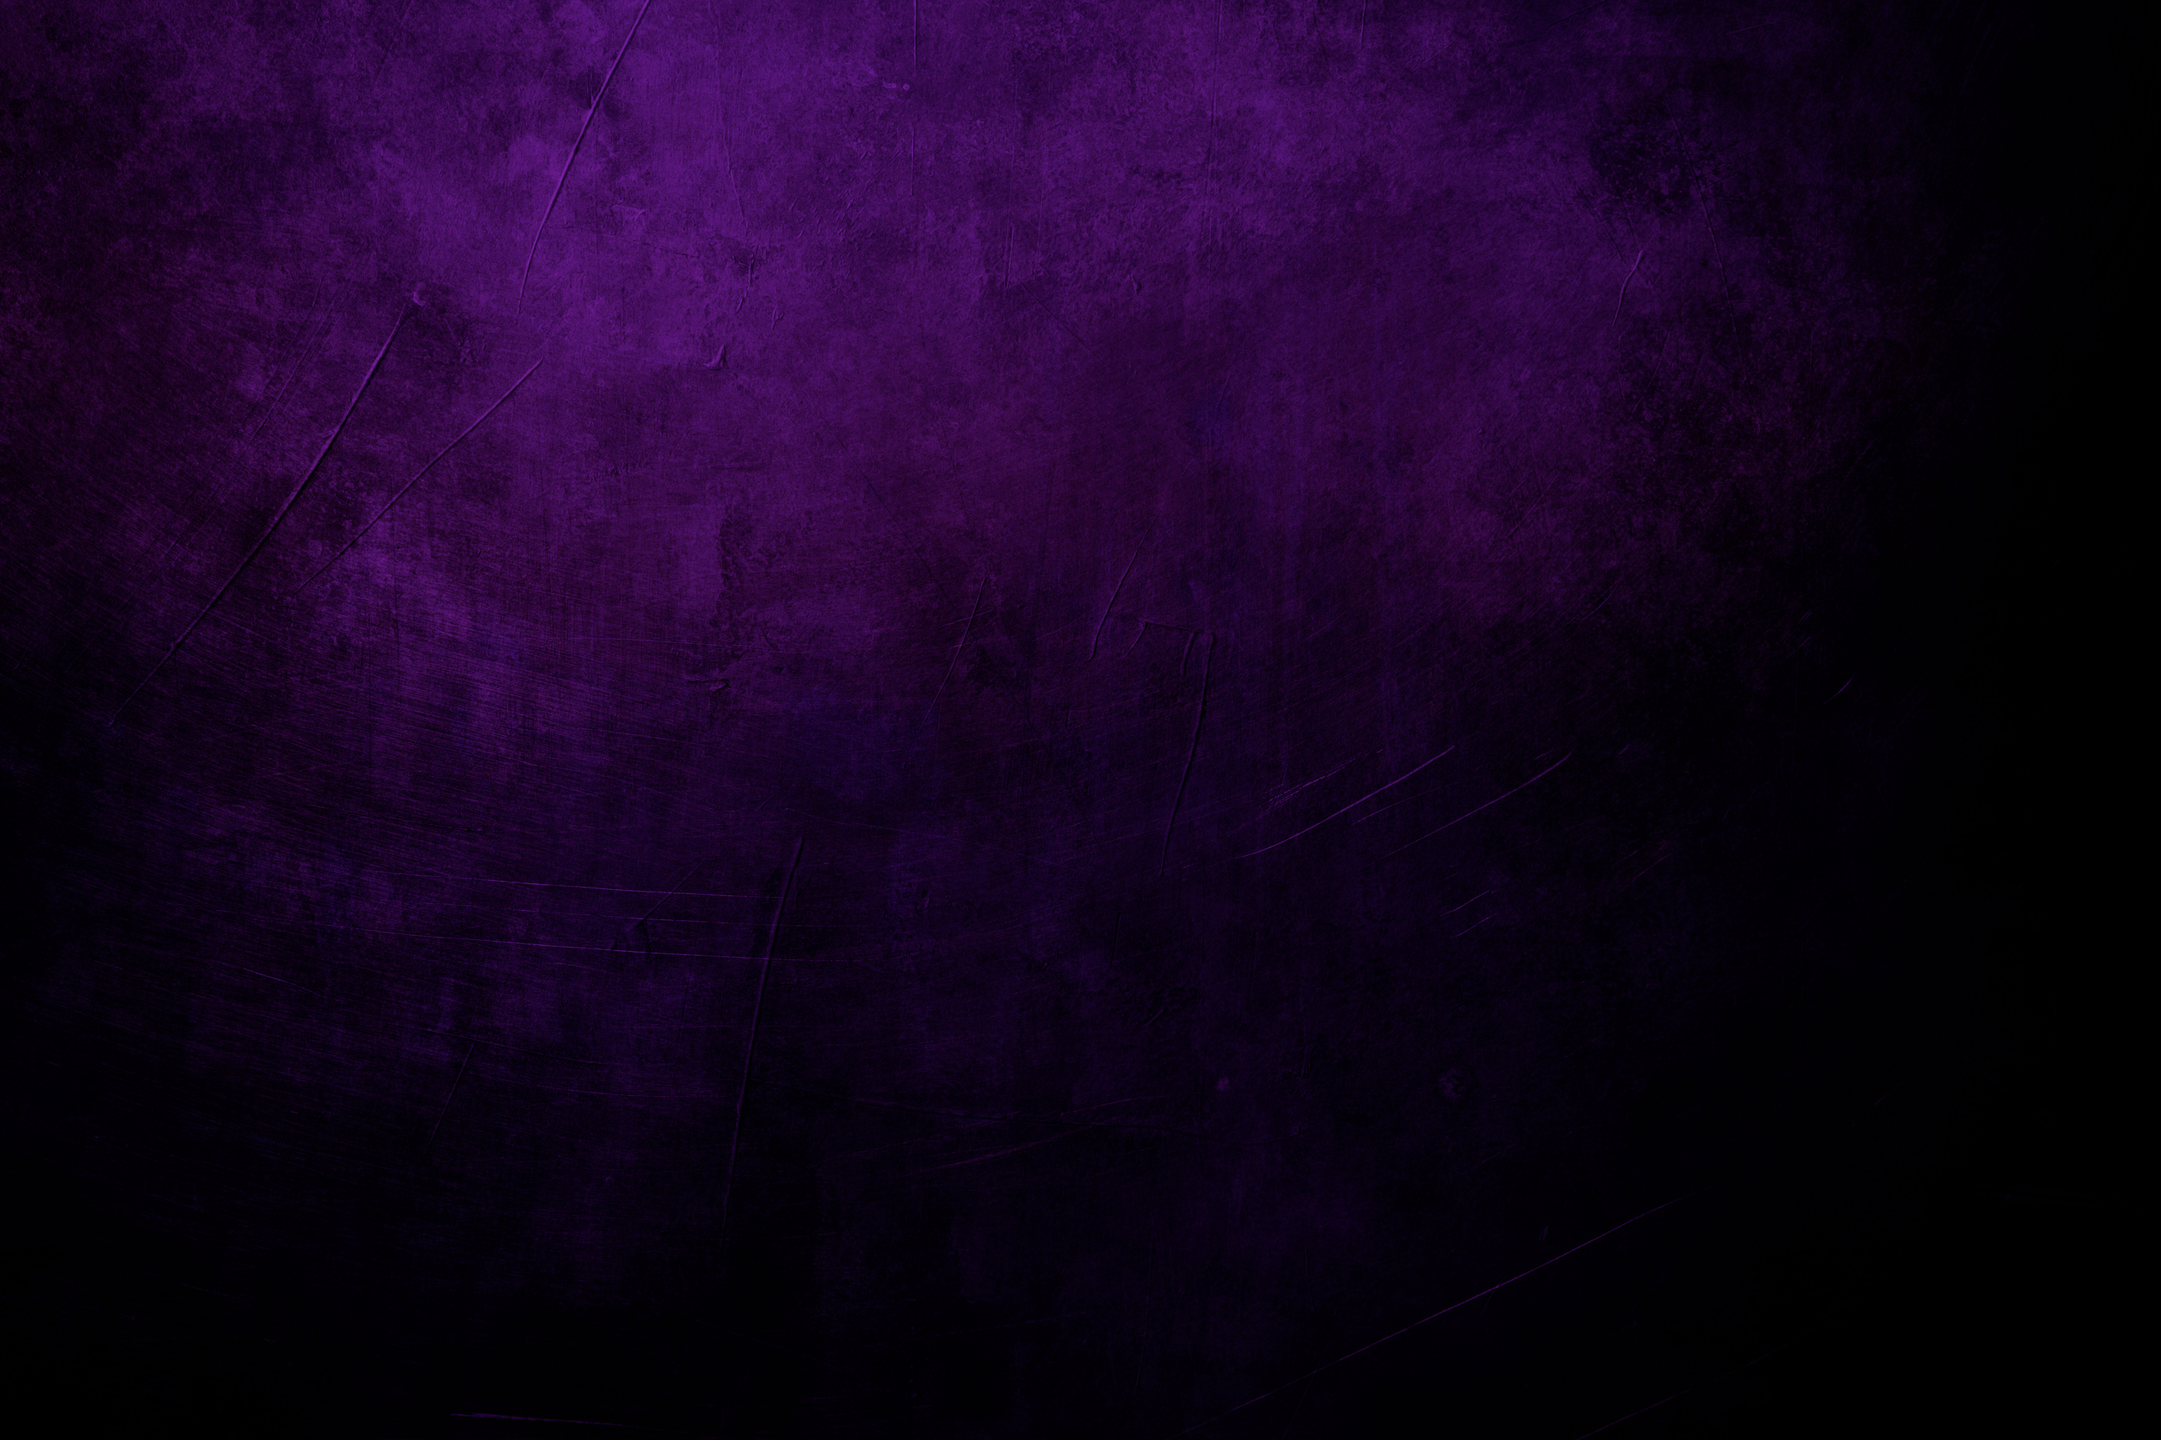
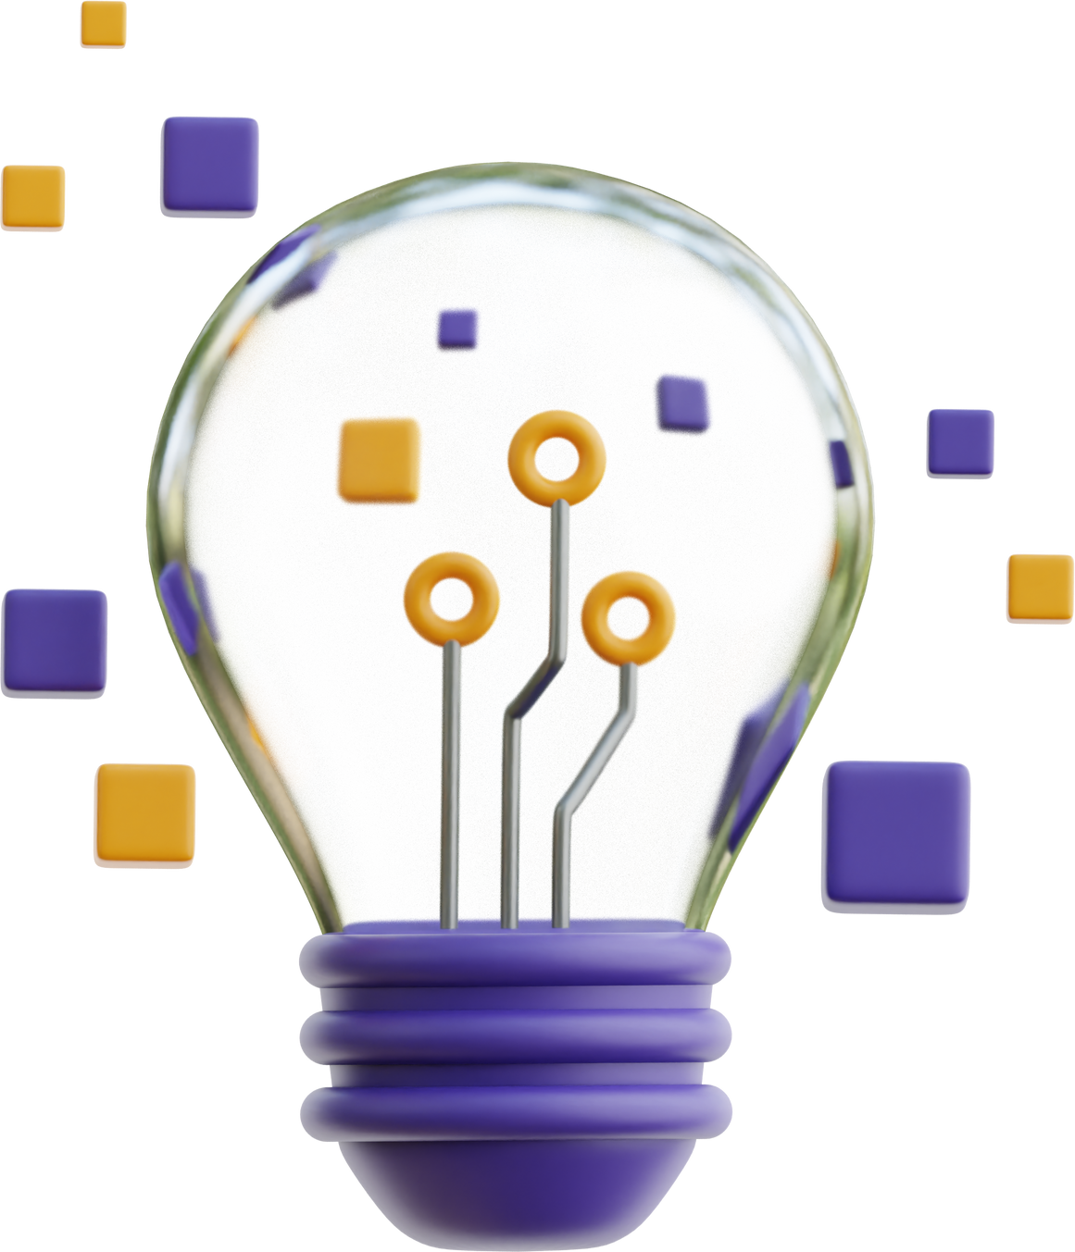
Synapse -X : Digital
Memory
The AI - Powered Consciousness Upload System
→ WHAT IF WE COULD LIVE FOREVER - DIGITALLY ?

Slide 8

THE REVOLUTIONARY SOLUTION : SYNAPSE - X
💡 A Neural-AI Fusion System that can digitally upload human consciousness.
💡 Imagine that your thoughts, memories, personality and intelligence can be uploaded into an AI-based immortal form.
💡 In the future, humans can create their AI clones to continue decision-making and intellectual growth!

Slide 9

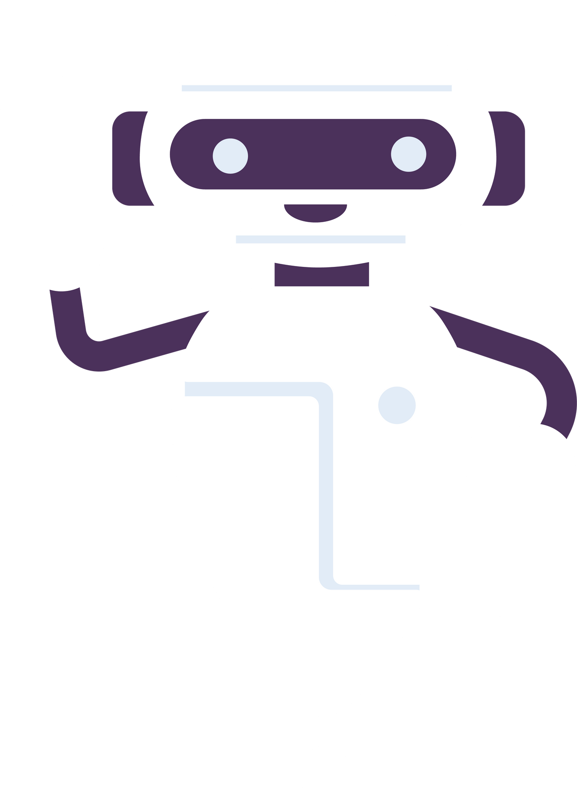

How It Works ?
→ BRAINWAVE MAPPING (EEG & fMRI Sensors)
→ AI-Driven Cognitive Modeling
AI will continuously analyze your neural patterns.
Machine learning will replicate your thoughts, memory patterns and personality.

Slide 10
How It Works ?
→ AI-Human Hybrid Interaction
→ Blockchain-Powered Identity Vault
The consciousness clone will be stored in a private, encrypted network
Your AI version will maintain virtual existence even after your death.

Slide 11
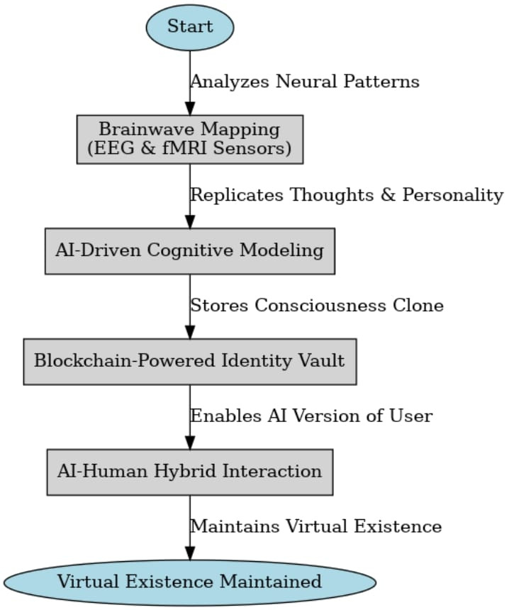

Slide 12


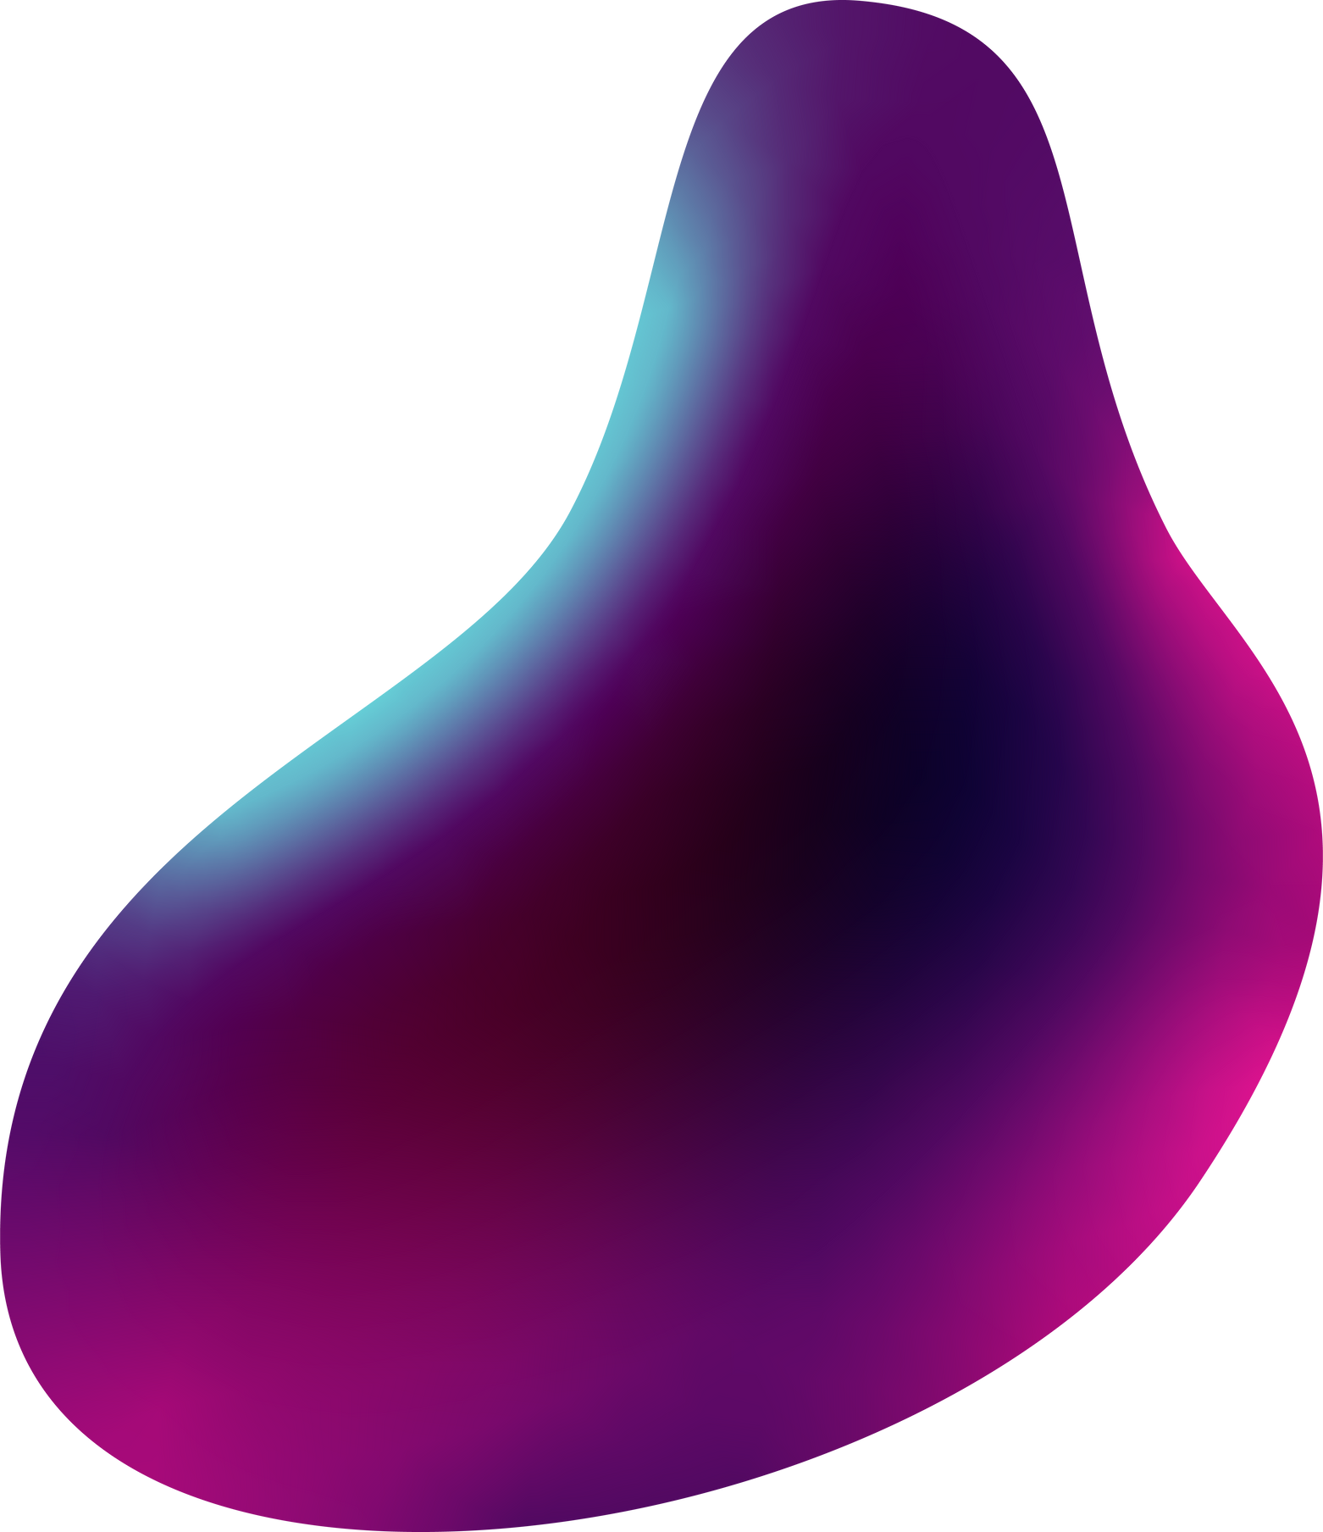
Key Features (Why It’s the Most Disruptive Idea Ever?)
Mind-to-Digital Transition: Thoughts and memories can be preserved in an AI assistant, making them immortal.
AI-Powered Decision Making: Business leaders, scientists or innovators can create their AI clone to preserve their thoughts for future generations.
Personalized AI Avatar: Your AI version will respond just like you, based on your learning, habit and behavior.
Digital Afterlife & Legacy: Your AI version will allow your family and friends to talk to you in the future.

Slide 13
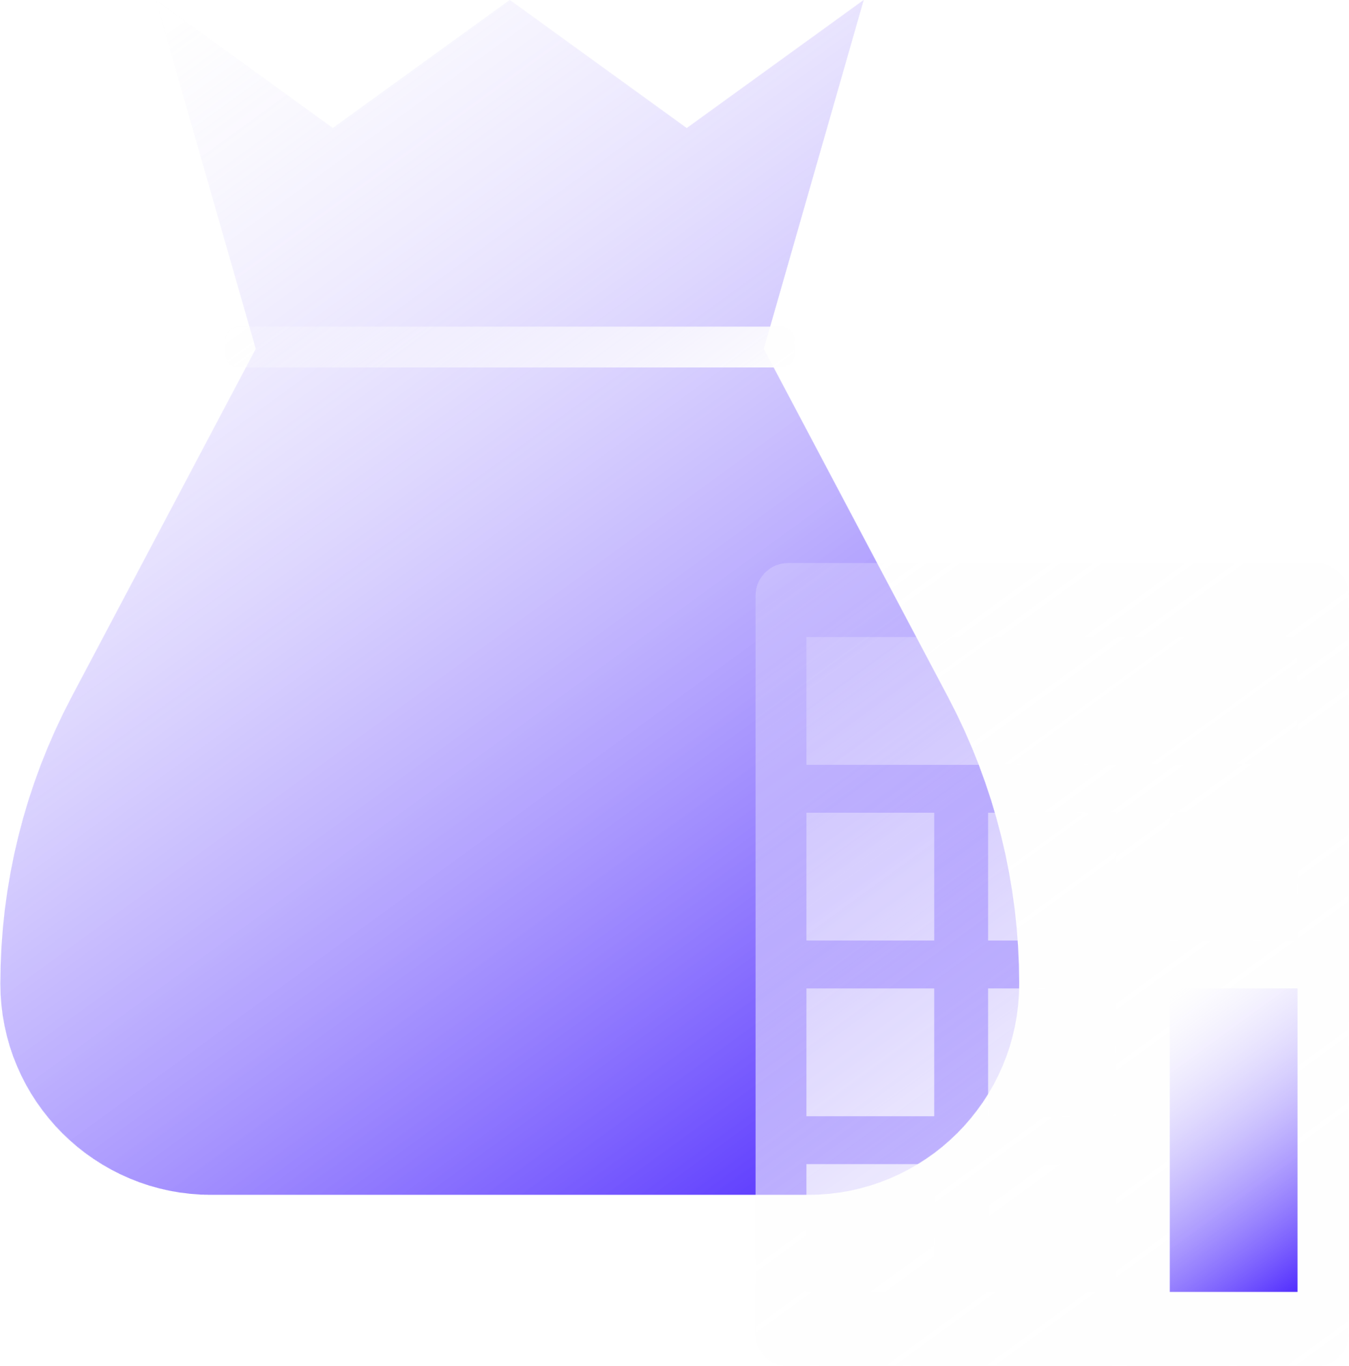
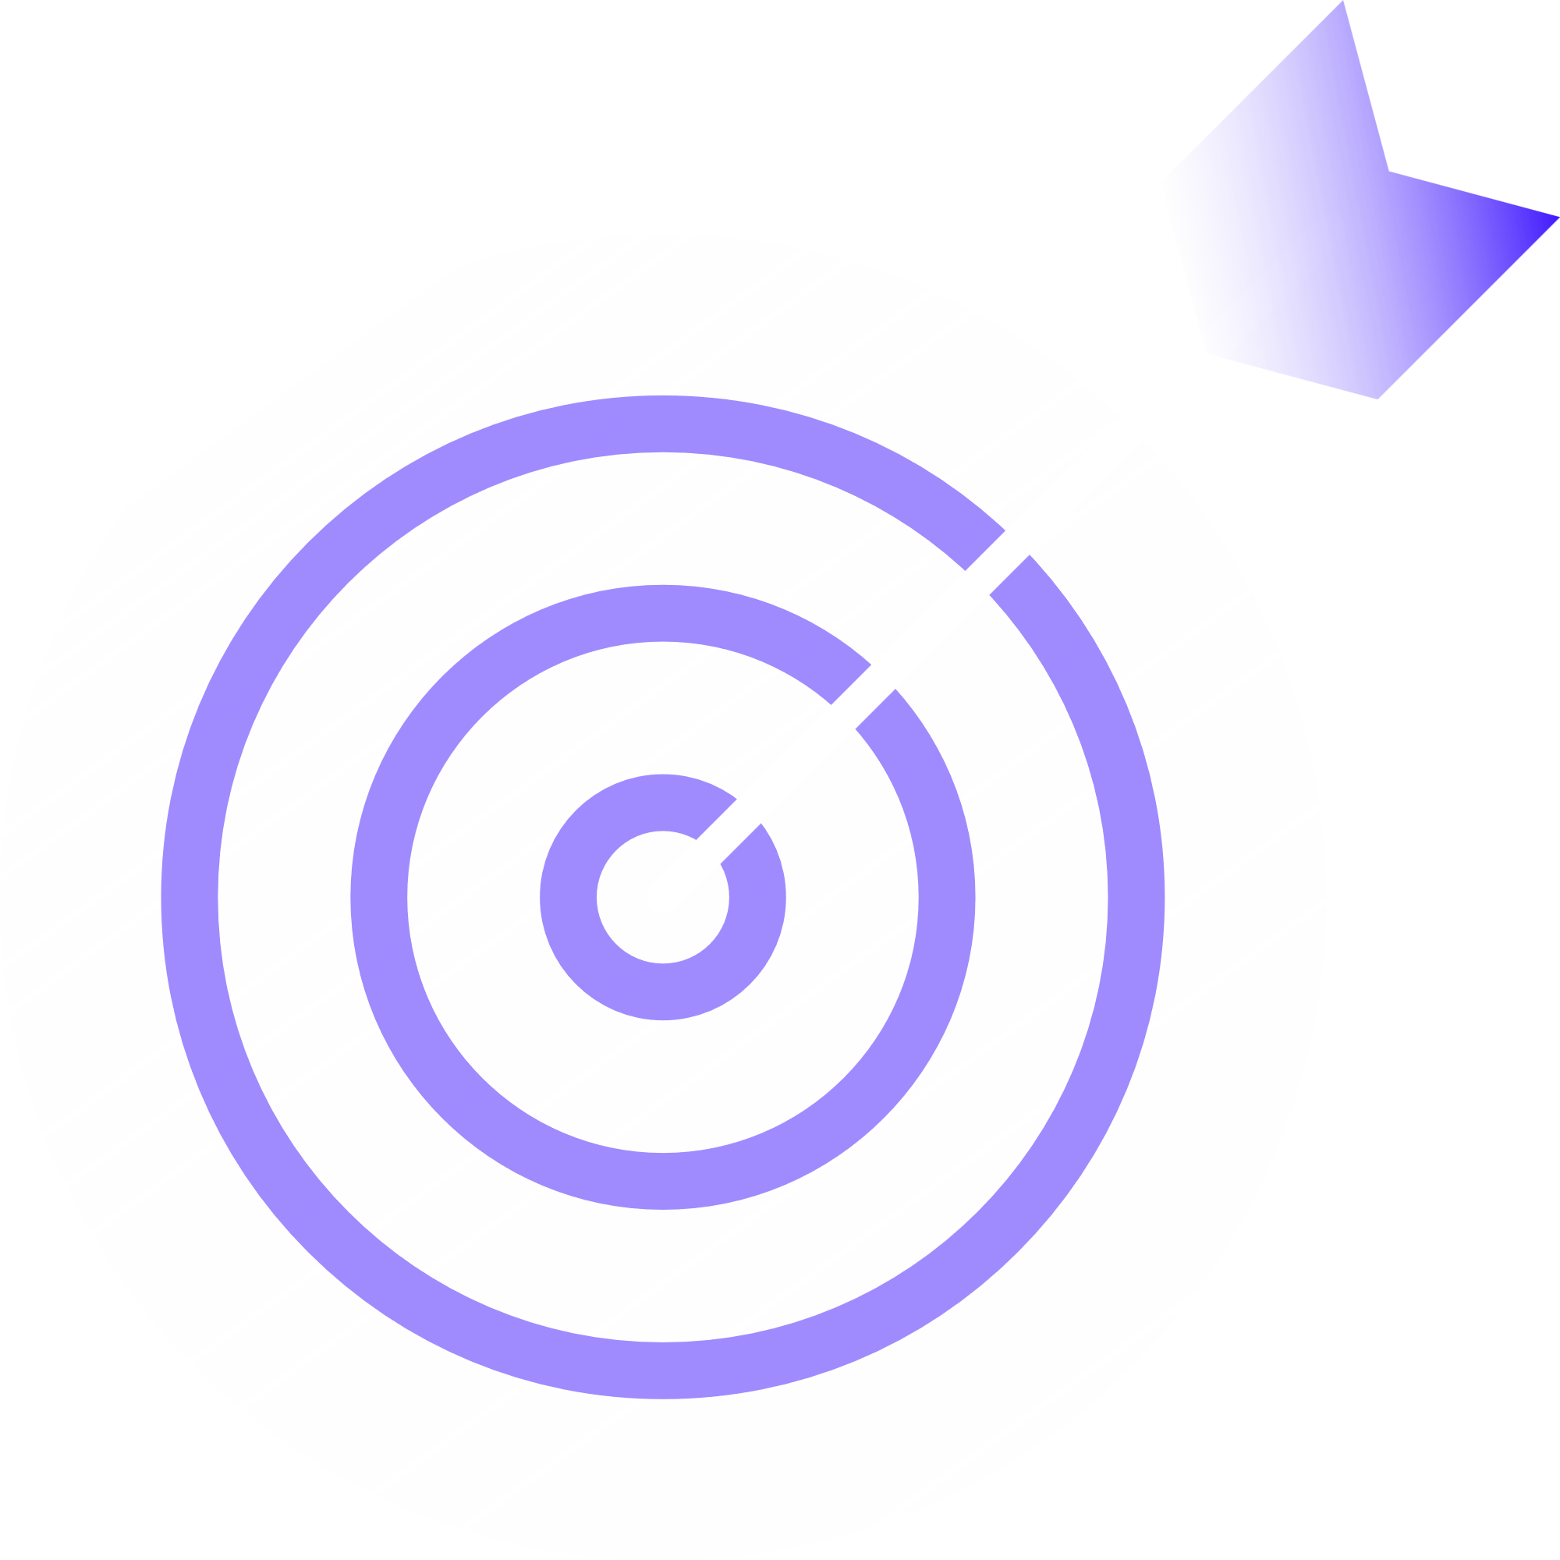

Market Potential & Business Model
📊 Market Size: AI & Neurotech Market = $500+ Billion by 2030
🎯 Target Audience: Innovators, scientists, entrepreneurs, historical preservationists, biotech industry.
💰 Business Model:
Premium Membership: AI training, personal consciousness uploads.
Enterprise Licensing: Exclusive digital consciousness transfer for billionaires & researchers.
Posthumous AI Legacy Services: Preserved AI clones for families and organizations.

Slide 14

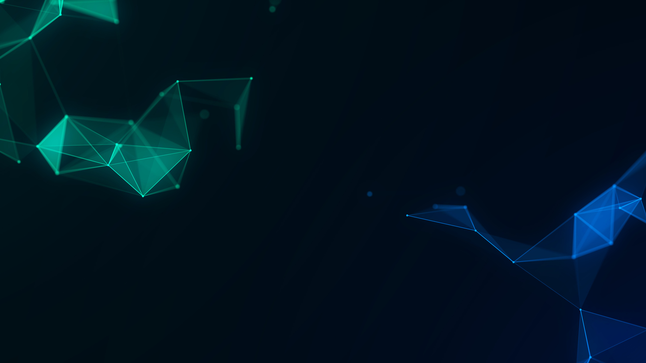
FEASIBILITY & VARIABILITY
Technical feasibility :- Our idea is built on cutting-edge yet accessible technology, ensuring smooth development and implementation. Potential challenges, such as integration with existing systems, can be addressed with scalable architectures and optimized frameworks.
Operational feasilibility :- The solution is designed with user-centric principles, making adoption seamless. Intuitive UI/UX, robust documentation and minimal learning curves ensure high user engagement annd acceptance across diverse auidences.

Slide 15
FEASIBILITY & VARIABILITY
Financial viability :- Cost-effective model with balancing development cost with long term sustainability. Revenue streams such as subscriptions, partnerships and premium features ensure continuous financial growth while maintaining affordability.
Scalability :- Our solution is built with future expansion in mind. It can handle increasing users and data loads efficiently, leveraging cloud computing, modular design and AI-driven optimizations for sustained growth without performance bottlenecks.

Slide 16

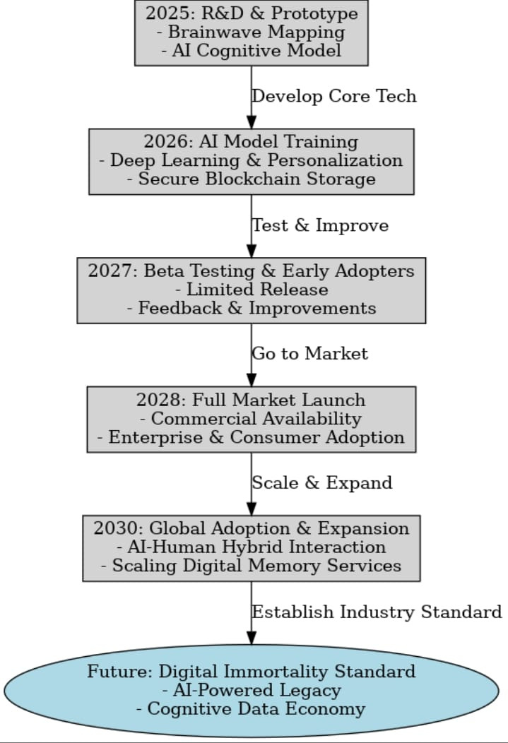

Synapse Digital Memory isn’t just a breakthrough—it’s the birth of digital immortality. Your mind, your legacy, your intelligence—preserved, evolved and alive forever.
CONCLUSION

Slide 17
Be a pioneer in the future of human intelligence. Partner with us, invest in innovation and redefine what it means to live beyond limits.
CALL TO ACTION !

Slide 18

Thank You

